Slide 1
SEQUENCES AND SERIES
Course Code : 19SSK221
Aptitude
Choodamani N

Slide 2
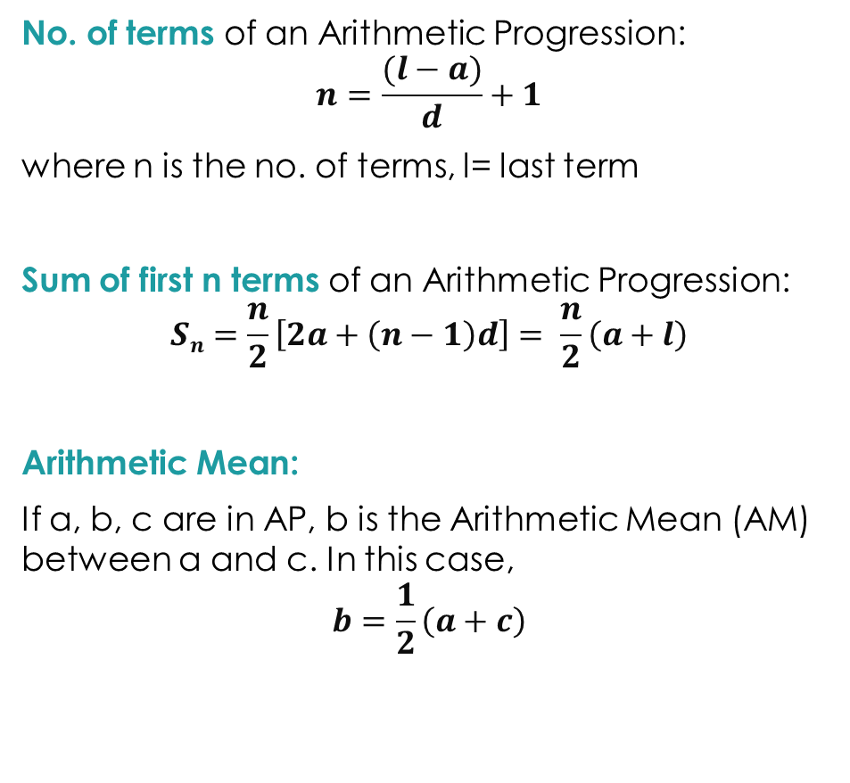
ARITHMETIC PROGRESSION
Arithmetic progression(AP) or arithmetic sequence is a sequence of numbers in which each term after the first is obtained by adding a constant, to the preceding term. The constant d is called common difference.
General Form of an AP :
a,(a+d),(a+2d),(a+3d),⋯ where a = first term, d = common difference
n^{th} term of an Arithmetic Progression:
l = t_{n} = a + (n-1)d
where t_{n} = n^{th} term, l = last term
No. of terms of an Arithmetic Progression:
$$n=\frac{(l−a)}{d}+1$$
where n is the no. of terms, l= last term
Sum of first n terms of an Arithmetic Progression:
$$Sn=\frac{n}{2}\left[2a+\left(n−1\right)d\right]= \frac{n}{2}\left(a+l\right)$$
Arithmetic Mean:
If a, b, c are in AP, b is the Arithmetic Mean (AM) between a and c. In this case,
$$b=\frac{1}{2}\left(a+c\right)$$

Slide 3
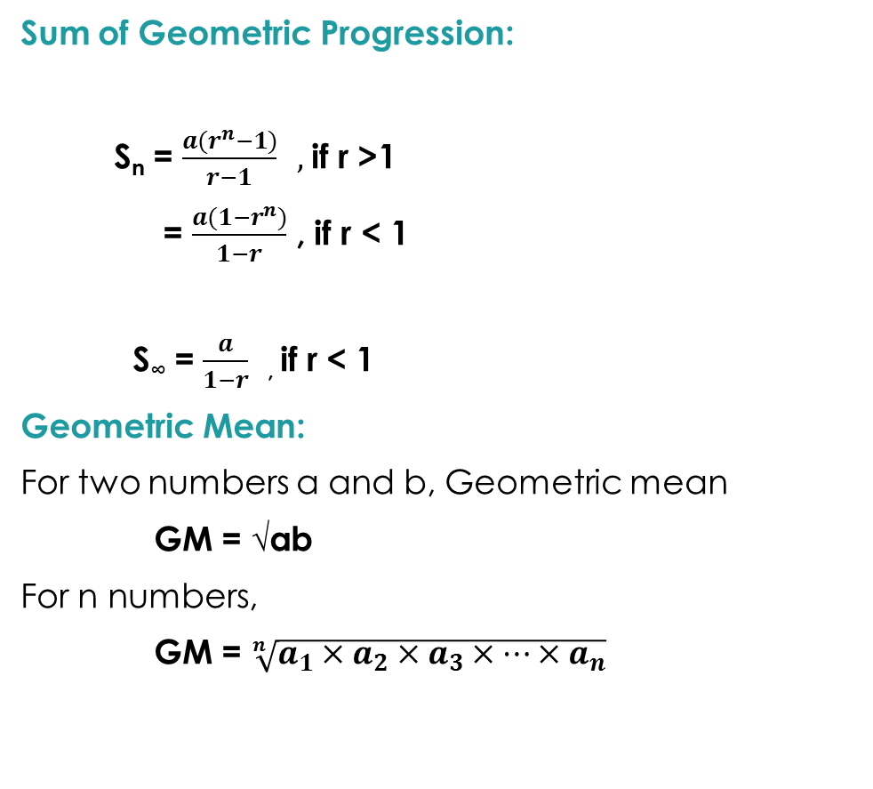
GEOMETRIC PROGRESSION
Geometric progression (GP) is a sequence of numbers in which the next term can be obtained by multiplying a fixed number to the previous number. This fixed number is called the common ratio and is represented by ‘r’.
General Form of an GP:
a, ar, ar², ar³, ………………..ar^{n-1}
nth term of a Geometric Progression:
l = t_{n} = ar^{n-1}
Sum of Geometric Progression:
S_{n} = $\frac{a(r^{n}−1)}{r−1} ,$if r >1
= $\frac{a({1−r}^{n})}{1−r}$ , if r < 1
S∞ = $\frac{a}{1−r}$ , if r < 1
Geometric Mean:
For two numbers a and b, Geometric mean
GM = √ab
For n numbers,
GM = $\sqrt[n]{a_{1}×a_{2}×a_{3}×…×a_{n}}$

Slide 4
HARMONIC PROGRESSION
A Harmonic Progression (HP) is defined as a sequence of real numbers which is determined by taking the reciprocals of the arithmetic progression that does not contain 0.
For example, the sequence a, b, c, d, …is considered as an arithmetic progression; the harmonic progression can be written as 1/a, 1/b, 1/c, 1/d, …
Harmonic Mean: Harmonic mean is calculated as the reciprocal of the arithmetic mean of the reciprocals.
Harmonic Mean = n /[(1/a) + (1/b)+ (1/c)+(1/d)+….]
Where,
a, b, c, d are the values and n is the number of values present.
The nth term of the Harmonic Progression (H.P) = 1/ [a+(n-1)d]
Relation Between AP, GP and HP:
For any two numbers, if A.M, G.M, H.M are the Arithmetic, Geometric and Harmonic Mean respectively, then the relationship between these three is given by:
G.M² = A.M × H.M, where A.M, G.M, H.M are in G.P
A.M ≥ G.M ≥ H.M

Slide 5


Solution :
Given, a₁₂ = a+11d = -13 -------(1)
S₄ =$\frac{4}{2}\left[2a+\left(4−1\right)d\right]$
24 = 2[2a + 3d]
2a + 3d = 12 ----------(2)
Solving (1) and (2)
d= -2, a = 9.
S₁₀ =$\frac{10}{2}\left[2\left(9\right)+\left(10−1\right)\left(−2\right)\right]$
S₁₀ = 5[18 + (-18)]
S₁₀ = 0
The 12th term of an A.P is -13 and the sum of the first 4 terms of it is 24. Find the sum of its first 10 terms.
A. -48 B. -26 C. 0 D. 52
l=a+(n-1)d
S_{n} =$\frac{n}{2}[2a+\left(n−1\right)d$

Slide 6

Solution :
Take difference of the numbers, d₁=5-1 = 4, d₂ =9-3 = 6, d₃ =5-9 = -4
Difference are not same here. So split the series.
[1 + 3 + 5 + 7 + ……. 15 terms] + [5 + 9 + 13 + 17 + …… to 15 terms]
a=1, d=2 a = 5, d = 4
S₃₀ = $\frac{15}{2}\left[2\left(1\right)+\left(15−1\right)\left(2\right)\right]+ \frac{15}{2}\left[2\left(5\right)+\left(15−1\right)\left(4\right)\right]$
S₃₀ = $\frac{15}{2}$[30] + $\frac{15}{2}$[66]
S₃₀ = [15×15] + [15×33]
S₃₀ = 225 + 495 =720
The sum of the following series 1+5+3+ 9 + 5 + 13 + 7 + 17 + .... to 30 terms is
A. 960 B. 780 C. 840 D. 720

Slide 7
Solution :
1
11 (There is one 1)
21 (There is two 1)
1112 (There is one 1 and one 2)
3112 (There is three 1 and one 2)
211213 (There is two 1, one 2, one 3)
312213
Find the next number in the sequence 1, 11, 21, 1112, 3112, 211213, .....
A. 2223113 B. 322324 C. 312213 D. 422426

Slide 8

Solution :
6 (2 & 3 – last number must be even, sum of digits must be divisible by 3)
The first number which is divisible by 6 is 204, 210, 216, …….., 498
Finding the number of terms by using the formula
n = $\frac{498−204}{6}+1=50$
S₅₀ = $\frac{50}{2}\left[204+498\right]$
S₅₀ = 25 × 702
S₅₀ = 17550
The sum of all the integers between 200 and 500 which are divisible by 6 is
A. 15000 B. 17550 C. 18000 D. 21000

Slide 9

Solution :
The first series 3, 7, 11, 15, 19, 23, ……… , 407 (d = 4)
Second series 2, 9, 16, 23, …….., 709 (d=7)
The common terms 23, 51, ……., 387 (Multiples of 28, 28*14 = 392 – 5)
n = $\frac{387−23}{28}+1$
n = 13 + 1 = 14 terms
Solution :
Let the no. of terms be 2n terms. Since it is given in the question, the no. of terms in an AP is even.
Consider the two arithmetic progressions 3, 7, 11, ...., 407 and 2, 9, 16, ..., 709. The number of common terms of these two progressions is
A. 0 B. 7 C. 15 D. 14
The number of terms in an A.P. is even, the sum of odd terms is 63 and that of even terms is 72 and the last term exceeds the first term by 16.5. Find the number of terms.
A. 8 B. 12 C. 9 D. 10

Slide 10
The sequence be like a₁, a₂, a₃, ………, a_{2n}.
a₁ + a₃ + a₅ + …… + a_{2n-1} = 63 -------(1) (Given : Sum of odd terms is 63)
a₂ + a₄ + a₆ + …… + a_{2n} = 72 -------(2)
Also given that, l – a₁ = 16.5
a₁ + (2n – 1)d – a₁ = 16.5
2nd – d = 16.5 -------(3)
Subtracting (2) from (1)
(a₂ – a₁) + (a₄ – a₃) + …………. (a_{2n} – a_{2n-1}) = 9
d + d + d + …….. + d = 9
nd = 9
Substitute the value of nd in eqn 3
2 × 9 – d = 16.5
d = 1.5
Subtitute d in nd = 9, n = 6
Since we have 2n terms => 2 × 6 = 12 terms.

Slide 11

Solution :
Let the common ratio be r and the terms be a, ar, ar², ar³, ar⁴ and so on in GP
Also given that third term is 4
ar² = 4
The product of the first five term will be
a × ar × ar² × ar³ × ar⁴ = a⁵r¹⁰ = (ar²)⁵
= (4)⁵ = 1024
Solution:
By looking at the series, a once, b repeats twice, c repeats thrice, ………. z repeats 26 times in the series.
a = 1, b= 2, c = 3, …….., Z = 26
No of terms of series forms the sum of first natural numbers (ie)$\frac{n(n+1)}{2}$
The third term of a G.P is 4. The product of first 5 terms is
A. 64 B. 256 C. 1024 D. None of these
The 288th term of the sequence a, b, b, c, c, c, d, d, d, d ...... is
A. U B. v C. w D. x

Slide 12

Substituting n = 23, $\left(\frac{23×24}{2}=276\right)$ (23rd letter ends in 276th place)
n = 24, $\left(\frac{24×25}{2}=300\right)$ (24th letter starts in 277th place)
24th letter starts from 277th place and ends in 300th place.
The answer is X.
Solution :
Given a, b and c are in AP, then b – a = c – b ------------(1)
Also given that b-a, c-b, a are in GP
Then (c - b)² = a(b – a) -------(2)
Substitute (1) here, (b – a )² = a(b – a)
b – a = a
b = 2a
In (2) substitute eqn (1), (c – b)² = a(c – b)
If a, b, c are in A.P., b - a, c - b and a are in G.P. then a : b : c is
A. 4 : 3 : 2 B. 2 : 3 : 4 C. 1 : 2 : 3 D. 3 : 4 : 5

Slide 13
c = a + b
c = 3a (since b = 2a)
So a : b : c = a : 2a : 3a = 1 : 2 : 3.
Solution :
Let GP be a, ar, ar², ar³.
Given a + ar = 12 --------(1)
and ar² + ar³ = 48
r²(a + ar) = 48
r²(12) = 48
r² = 4 => r = ± 2
Here r = 2 is rejected (sign of GP alternatively positive and negative, so ratio is negative)
a + ar = 12 => a(1-2) = 12 => a = -12.
The first two terms of a geometric progression add up to 12. The sum of the third and the fourth terms is 48. If the terms of the geometric progression are alternately positive and negative, then the first term is
A. -2 B. -4 C. -12 D. 8

